Slide 1
HW-10 Prediction Challenge 2
-Nitin Gowda

Slide 2
Decision tree
2nd tree model:
Dtree2 <- rpart(Grade ~ Score, data = M2022train, control = rpart.control(minbucket = 50))
rpart.plot(Dtree2)
Accuracy: 72%

Slide 3
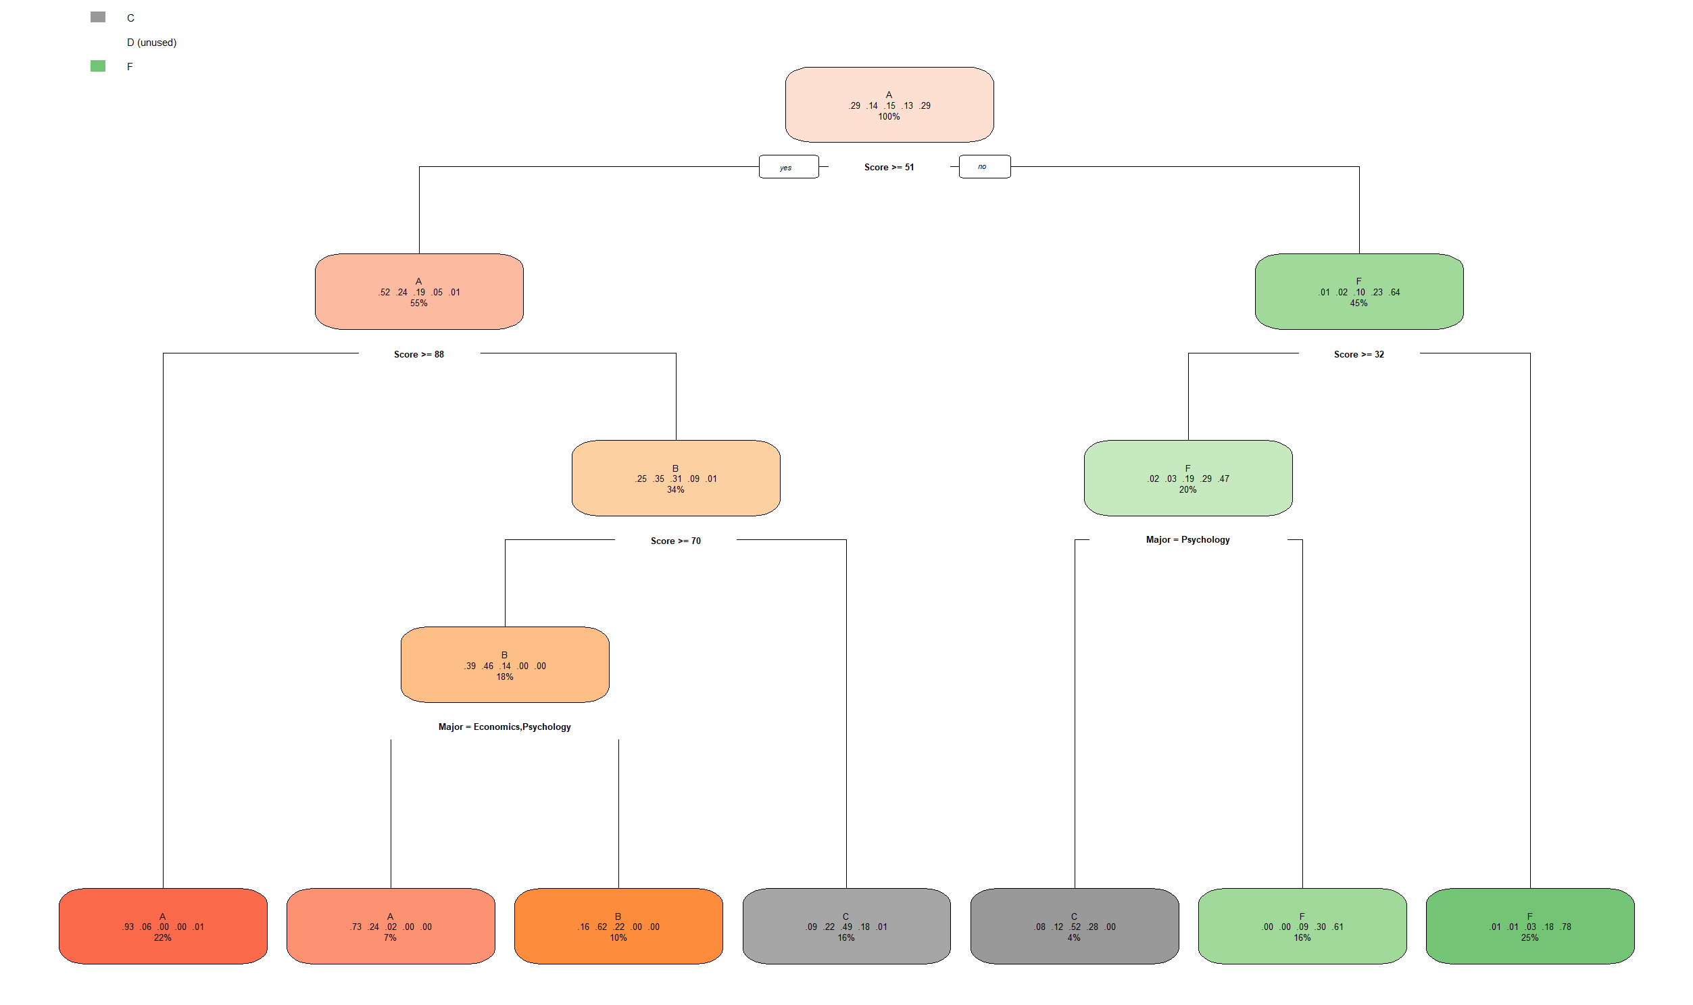
Cross-validation
cross_validate(M2022train,Dtree1, 1, 0.8)
This gives accuracy of 72%

Slide 4
Decision tree (continued)
3rd tree model:
Dtree3 <- rpart(GRADE ~ SCORE, data = M2022train, control = rpart.control(minsplit =50))
rpart.plot(tree3)
Accuracy: 76%

Slide 5
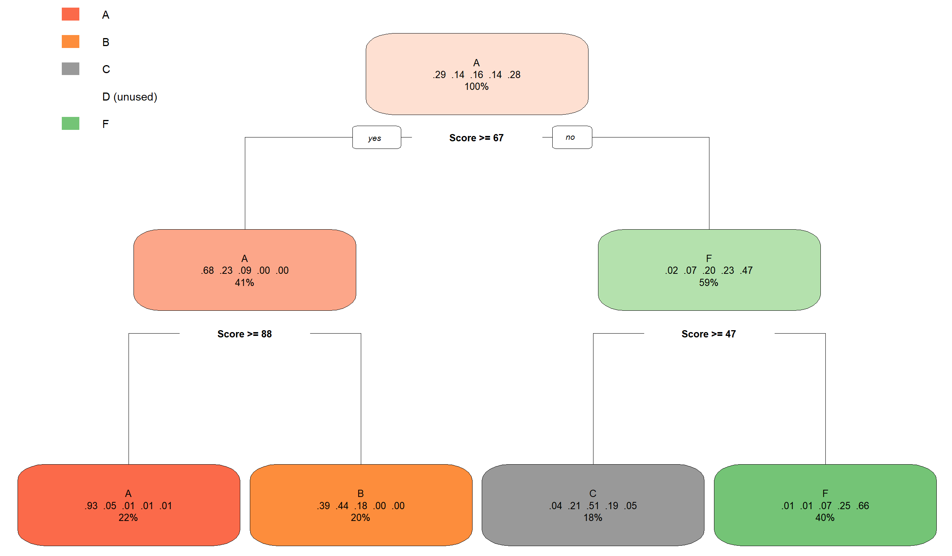
Cross-validation
cross_validate(M2022train,Dtree2, 1, 0.8)
This gives an accuracy of 76%

Slide 6
Decision tree for data (final)
1st tree model:
Dtree <- rpart(Grade ~ Score, data = M2022train,control=rpart.control(minsplit = 50, minbucket = 50))
rpart.plot(tree)
Accuracy: 81%

Slide 7
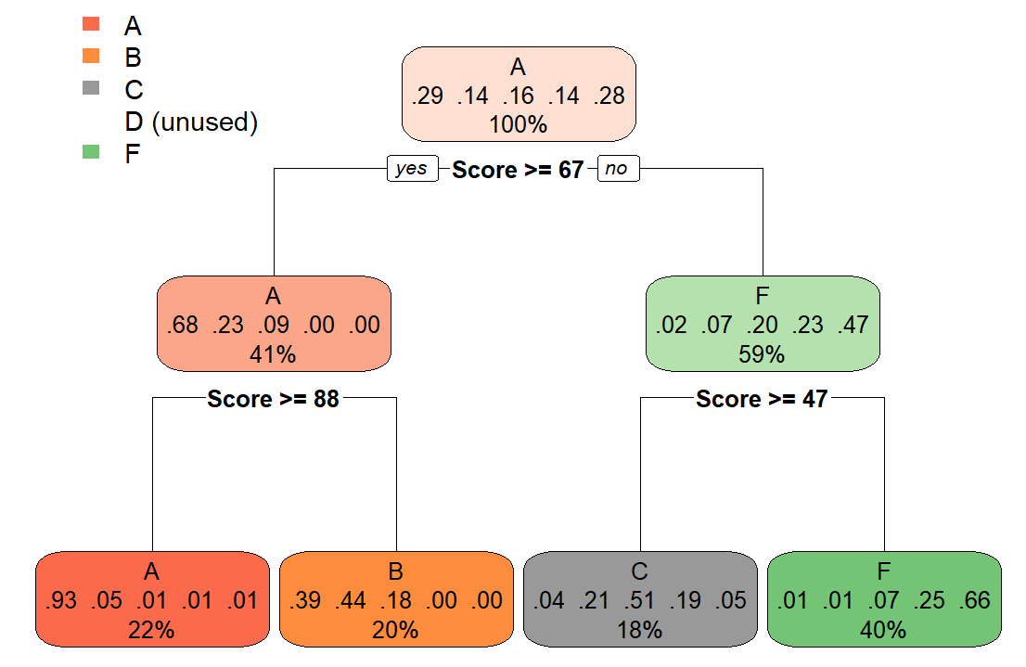
Cross-validation (final)
cross_validate(M2022train,Dtree1, 1, 0.8)
This gives an accuracy of 81%

Slide 8
Conclusions:
Using only minsplit gives us a model of accuracy 76%
Using only minbucket gives us a mode of accuracy 72%
It was found that using both controls minsplit and minbucket seem to provide the most accurate tree model of 81%
Therefore, the first decision tree works best, i.e. Dtree1

